Slide 1
Data You Can Use to Prepare Your Budget
Steve Miller CPA – Senior Product Manager
January 11th, 2017

Slide 2
Sources of Revenue

Slide 3
Per Pupil Spending
 | 2015 | 2016 | % Change
State-wide | $11,906 | $12,101 | 1.6%
Region 1 | $11,995 | $12,446 | 3.8%
Region 2 | $11,522 | $11,839 | 2.7%
Region 3 | $11,783 | $11,715 | -0.6%
Region 4 | $13,914 | $14,328 | 3.0%
Region 5 | $12,865 | $12,898 | 0.3%
Region 6 | $11,280 | $11,412 | 1.2%
Region 7 | $10,585 | $10,624 | 0.4%
Region 8 | $10,542 | $10,894 | 3.3%

Slide 4
Top Expense Growth Areas - Function
Function | Increase
63500 – School Bus Purchase | 65.7%
66200 – Site Improvement | 52.8%
68400 – Technology - Attendance | 44.0%
68600 – Technology - O&M | 29.3%
68500 – Technology - Transportation | 27.6%
66600 – Building Improvements | 9.9%

Slide 5
Top Expense Growth Areas – Instruction Functions
Function | Increase
61220 – Social Work | 5.0%
61310 – Improvement of Instruction | 4.5%
61410 – Office of the Principal | 2.2%
61100 – Classroom Instruction | 2.1%
61320 – Media Services | 1.9%
61210 - Guidance | 1.8%
Notes:
?

Slide 6
Top Expense Growth Areas - Object
Object | Increase
6060 – Technology Infrastructure | 47.1%
8230 – Capitalized Software | 30.6%
8210 – Technology Hardware Additions | 29.4%
8110 – Technology Hardware Replacements | 29.4%
8200 – Capital Outlay | 14.7%
8120 – Technology Infrastructure Replacements | 12.1%
5001 – Telecommunications | 11.6%

Slide 7
Technology Spending
In FY2016 school divisions spent $125 million more on technology than they did five years earlier, a nearly 20% increase
State-wide, the average spent per student on technology in FY2016 was just under $600 (this includes hardware, software, infrastructure and support) with a range in per student spending of $80-$2,243
The average breakdown of technology spending for 2016 was:
Salaries and Benefits | 47.0%
Purchased Services | 15.7%
Supplies & Materials | 23.0%
Capital Outlay | 13.6%
Other | 0.7%

Slide 8
Average Teacher Salary
 | 2015 | 2016 | % Change
State-wide | $54,274 | $54,699 | 0.8%
Region 1 | $49,570 | $49,475 | -0.2%
Region 2 | $52,082 | $52,337 | 0.5%
Region 3 | $50,893 | $51,146 | 0.5%
Region 4 | $63,061 | $63,439 | 0.6%
Region 5 | $47,744 | $48,907 | 2.4%
Region 6 | $47902 | $48,624 | 1.5%
Region 7 | $43,528 | $43,618 | 0.2%
Region 8 | $44,283 | $44,148 | -0.3%

Slide 9
Medical Insurance Premiums
 | 2015 | 2016 | % Change
Employee | $6,019 | $6,262 | 4.0%
Employee +1 | $7,779 | $8,172 | 5.1%
Family | $9,839 | $9,974 | 1.4%

Slide 10
Putting your Money Where your Mouth is
Forecast5 CEO Mike English:
http://forecast5analytics.com/blog/putting-your-money-where-your-mouth-is/
Has there typically been a financial plan behind your academic/strategic plan?
Do you measure it like you do your academic outcomes?
Are you putting your money where your mouth is?

Slide 11
Putting your Money Where your Mouth is

Slide 12
Putting your Money Where your Mouth is

Slide 13
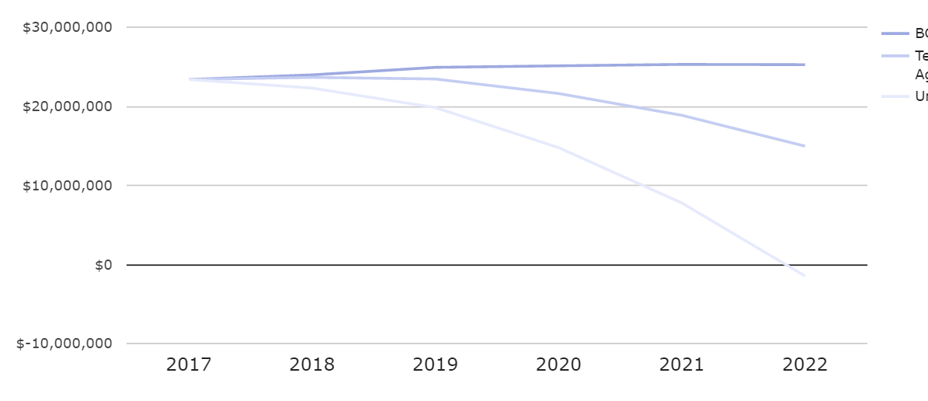
5Cast

